Slide 1

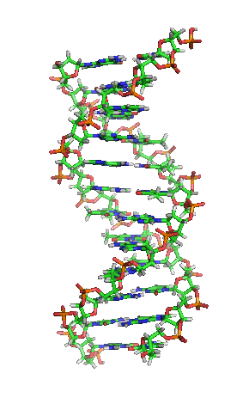
Ethical, Social, technological, and environmental issues
Analysing Controversial Topics in genetics
Ramnik CHudha
Genetics STSE
SBI 3U

Slide 2

Defining and understanding the eugenic theory

Slide 3
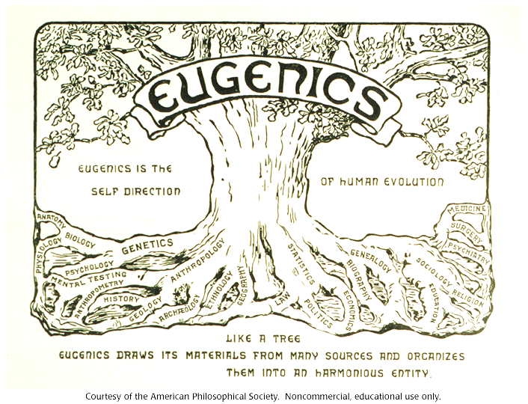
“the self direction of human evolution”
Eugenics is a theory based on selective breeding that was popular in the 1880’s
Started by the ideology of Sir Francis Galton
Galton believed that society was over-sympathetic for the weak, and that this was slowing human evolution
“Eugenic” means well born
Eugenics is all about improving and enhancing the evolution of humans

Slide 4
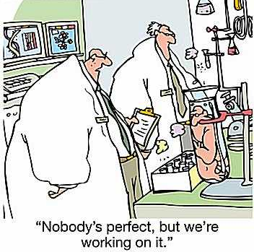
What are Eugenics?
In humans, the objective of eugenics is mainly to remove disease, disability, imperfections and other genetically inherited undesirable traits from the human race.
Known as improving the human race by growing the amount of qualities and reducing/eliminating undesirable traits.
Eugenics is an effort to genetically improve a species, through a variety of methods and practices that eliminate undesirable alleles

Slide 5

Examples of Eugenics
Various methods and practices that follow the Eugenic Ideology

Slide 6
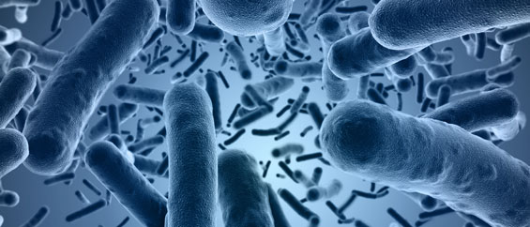
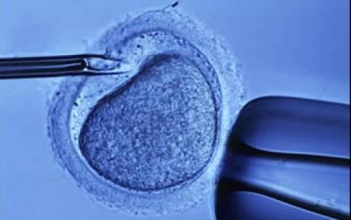
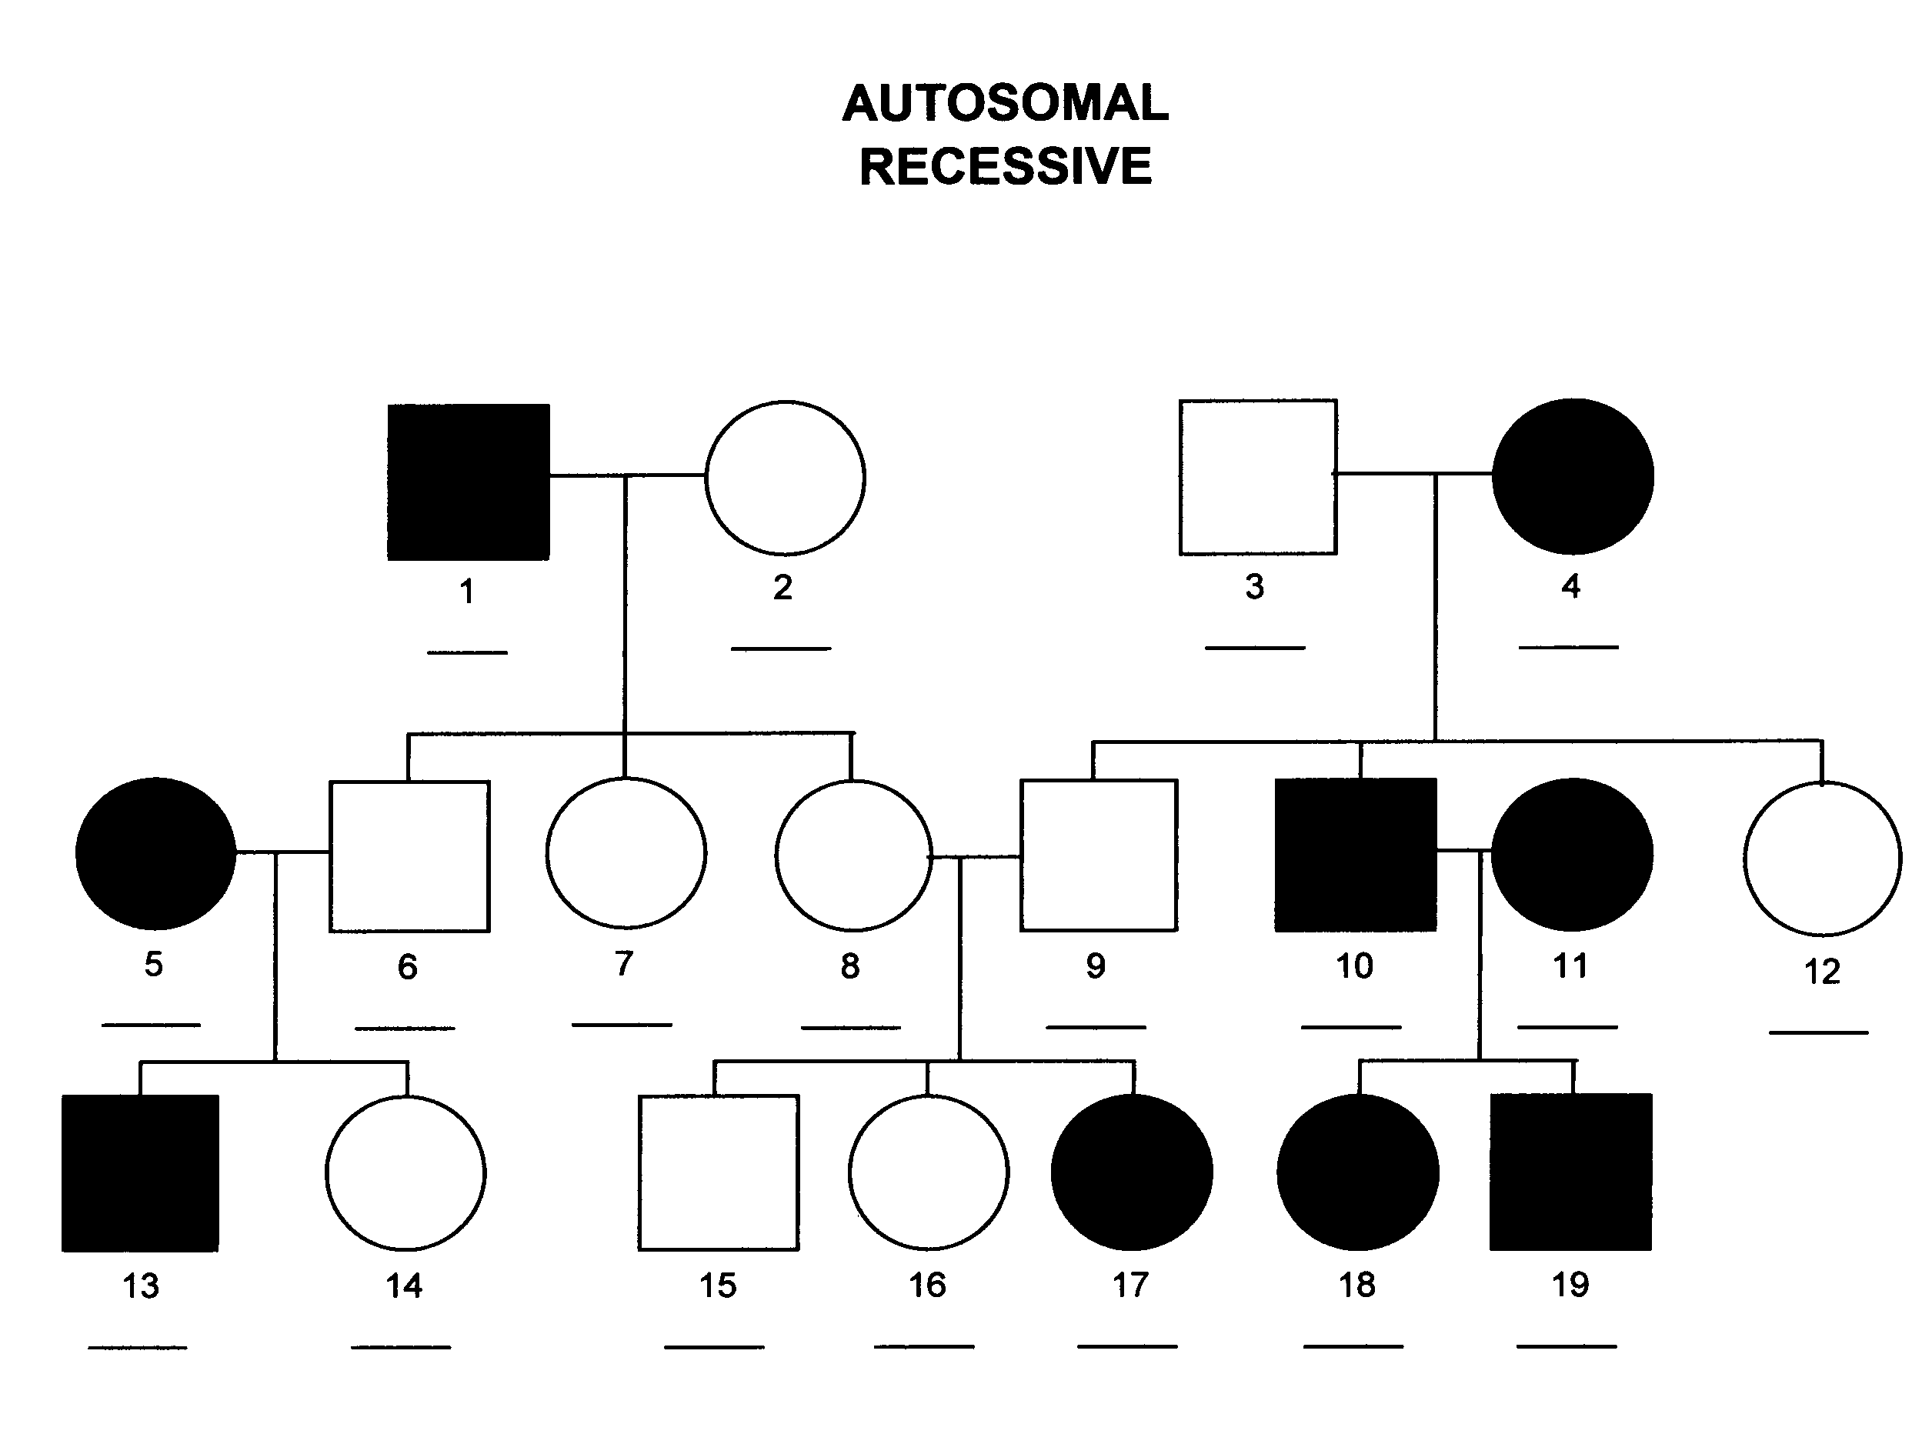
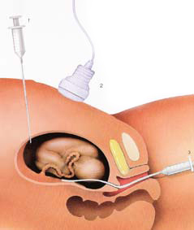
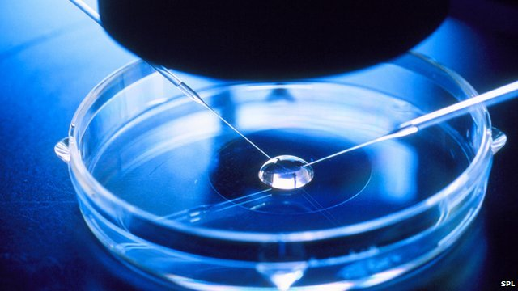
Examples of Eugenics
Sterilization
main technique in the Eugenics belief
Prohibiting people with undesirable genotype/phenotype from reproducing and possibly having offspring with the same/similar undesirable trait/allele.
This may include the removal/alteration of reproductive organs to terminate fertility
Encouraging people with desirable gene/trait to have many offspring

Slide 7
Examples of Eugenics
PGD
In Vitro Fertilization
Gene Therapy

Slide 8

benefits to the human race, new scientific breakthroughs

Slide 9
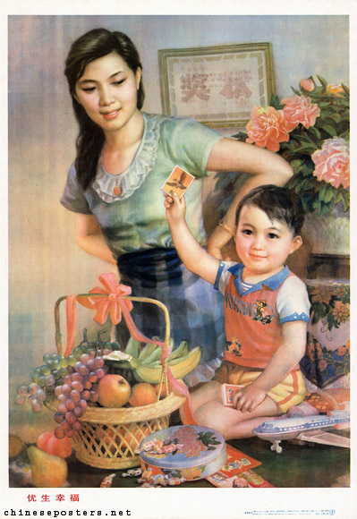
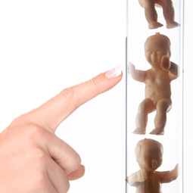
Decreased Disease, disorders, and Disabilities
Disabilities and disorders can create many hardships for the affected individual and their families
Decreasing or eliminating these undesirable traits would mean that more children have a greater chance at being happy, healthy and successful in life.
90% of babies tested to have down syndrome are aborted before birth, shows how majority of parents prefer not to have children with disorders
Supporters of Galton’s Eugenic theories also believed that providing medical care to the “weak” for an increased chance to survive is an effort that does not allow nature to take its course and eradicate “defective” people

Slide 10

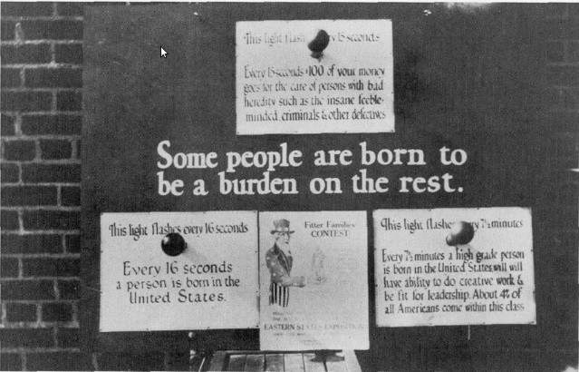

Less strain on society/economy
More people with disabilities and disorders means more strain on the economy
Less disabilities and disease means less patients in hospitals and therapeutic clinics, this would mean less taxes go towards their treatment/therapy
Less defects/disabilities means less taxes going towards disability tax credits, and programs made for health care of these affected individuals
Majority of individuals with disabilities are poor, under-educated and under-employed due to unequal opportunities

Slide 11
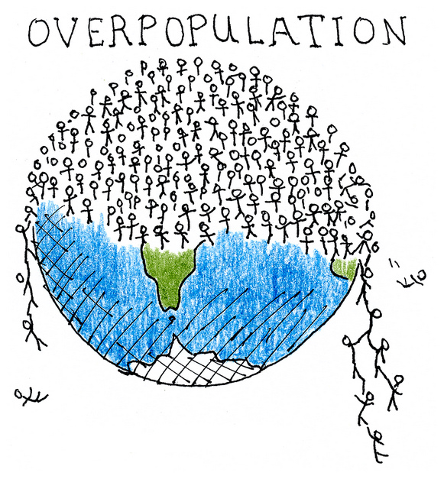

Saving the environment
Humans consume too much! Food, oil, land, resources….
Humans leave too large of a carbon footprint, we are constantly contributing to the concentration of CO2 in our atmosphere, litter of plastic in the lithosphere…
Scientist believe that one day the world will not be able to support such a large population of humans
Eugenics through sterilization decreases the population, since less offspring are born.
Also, the children and generations that are born will continue to be healthier and more intelligent
A smaller population with greater intelligence would not only decrease the strain on resources, but the smarter individuals born would be able to innovate new eco-friendly inventions, and work towards saving the planet by finding solutions to things like global warming and exhausting resources.

Slide 12
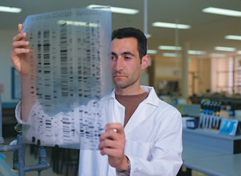
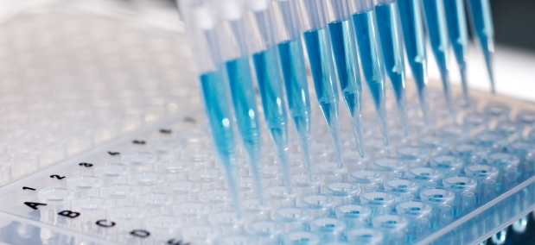
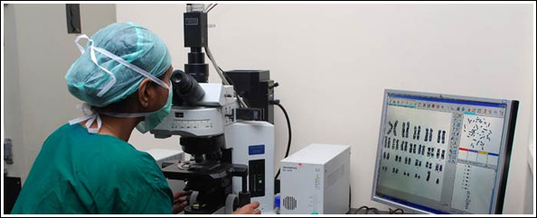
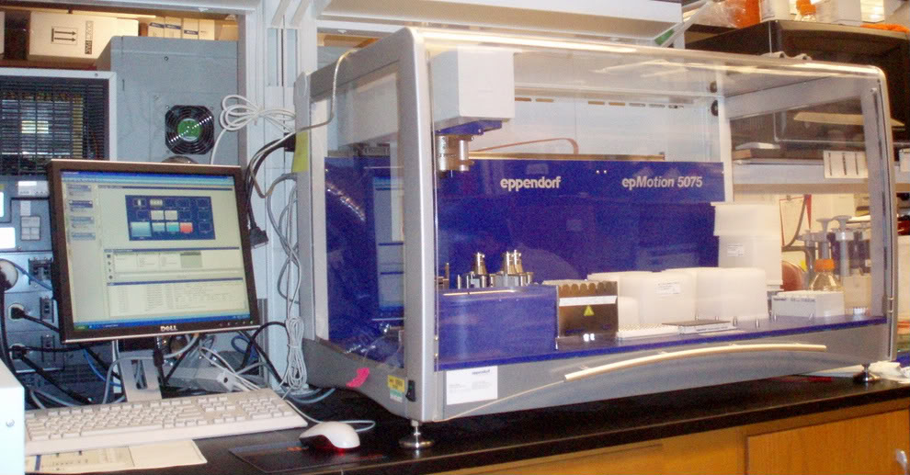
Scientific Discovery and research
Eugenics, biomedical science/engineering, and genetic engineering are all popular emerging topics in scientific research
Eugenics allows further research of how diseases and defects exist in DNA, and how they can be treated
Supporting Eugenics allows scientists to further explore human inheritance, DNA, genes, and evolution
Anthropology is very closely related to Eugenics, because it also studies the evolution of humans.

Slide 13
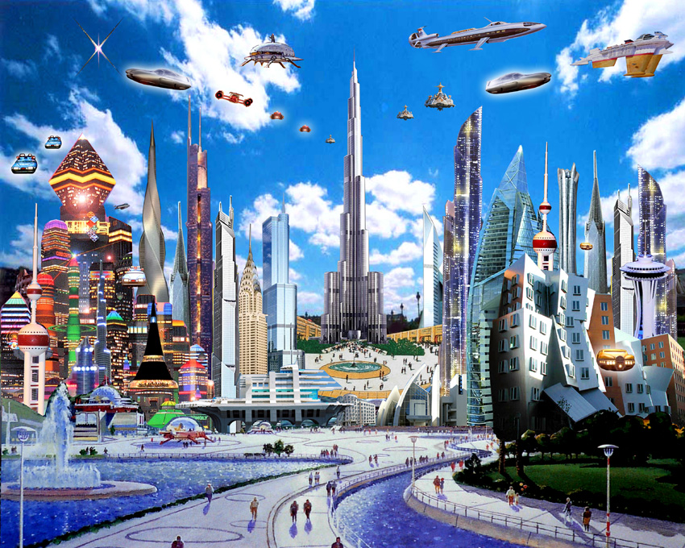
Leading mankind into the future
The world wants and needs smarter people
If you think about it, the amount of knowledge and data we have in our world continues to grow. For instance, new scientific discoveries and math equations are constantly updated into school curriculums
Technology is advancing so fast, individuals must stay in universities longer to learn all the info and keep up-to-date with data in order to keep improving and innovating in our world.
There is a theory stating that one day all this info and education required to keep up and continue to improve will surpass the amount of data the human brain can hold.
This presents the need for smarter, more intelligent humans
Eugenicists believe that humans need to evolve into more intelligent species faster in order to continue to continue evolution and move forward into the future

Slide 14

Ethical and social, issues, Grim History and discrimination

Slide 15
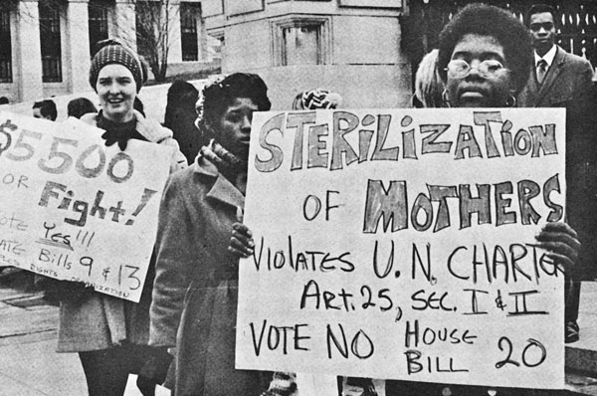
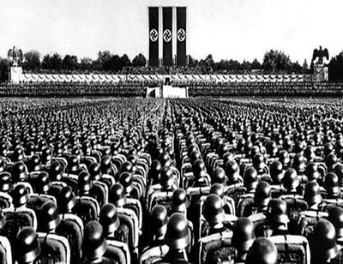
A dark past

Slide 16
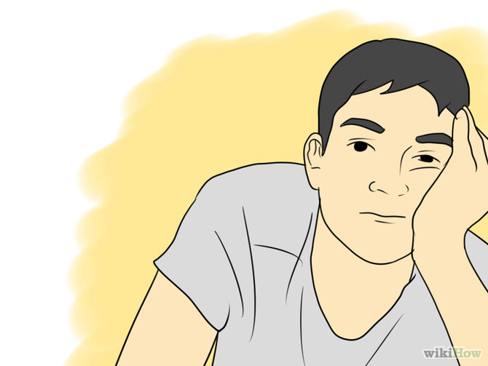
Unavailable technology
The technology and money required to fund different methods of eugenics is not available in many countries, for example developing/third-world countries

Slide 17

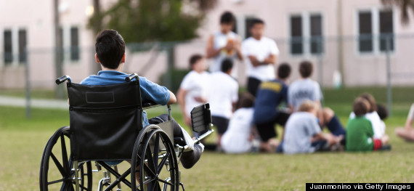
Discrimination
Some disability groups believe Eugenics encourage discrimination against diseased, disabled or “imperfect” people.
Already people with disabilities or disease face exclusion from bullying and unfit public environments that don’t always offer the resources they need (ex. Not enough ramps or wide doors for wheelchairs)
If we were to further minimize the population of these “undesirable” people with disease/disability, this even smaller minority of people would likely face even more discrimination
Others also support the idea that everyone has the right to live, whether they are/aren’t considered perfect in the eyes of society.

Slide 18

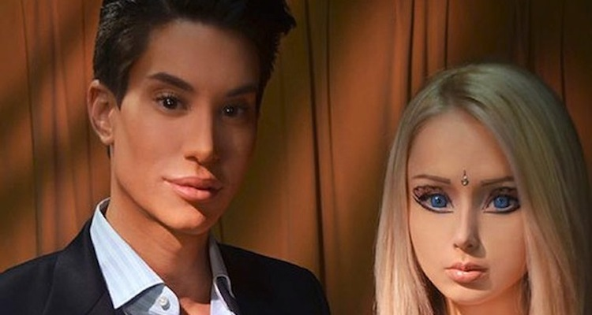
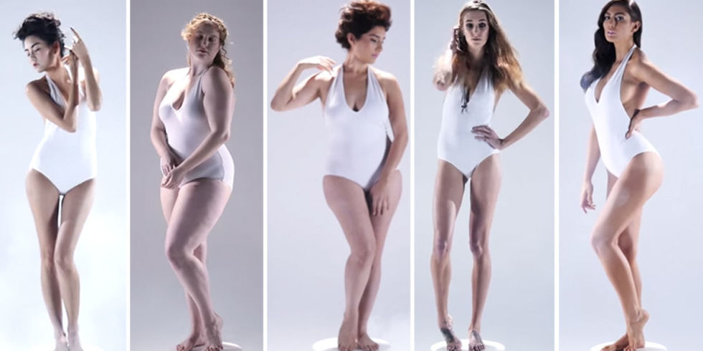
Changing Society standards
As Eugenics may continue to improve more and more qualities of a human, when will we finally be perfect?
Eugenic methods are not only used to prevent disability/disease, but also used to enhance intelligence and appearance through a variety of methods.
Since history, the model of a perfect looking human has been changing with society (ex. The ideal woman’s body shape)
The physical traits that were considered desirable/undesirable ten years ago may not be even close to the standards society has today.
If eugenics is all about perfecting the human race, including its appearance, then how can we decide what is perfect when these opinions may change with time?
The answer is, that we will never be able to stop perfecting ourselves if eugenics allows society so many opportunities to tweak appearance.

Slide 19
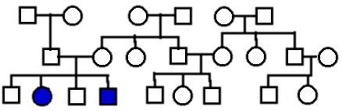
It May Never work anyways
Although sterilization will decrease the number undesirable genes in each generation, it cannot completely get rid of this allele.
Homozygous recessives and carriers still result as some offspring when using the sterilization method (ex. when heterozygotes reproduce).
By numbers, there are over 1000 disorders known to be inheritable. This number does not even account for other inheritable traits like appearance and intelligence.
The large number of inheritable undesirable genes combined with a large population makes it very difficult to track so many traits through such a large population, which makes eugenic procedures hard to implement, manage and record.
Eugenics is all the about improving the human race as a whole, but there are simply too many undesirable genes and too many people in the human race for the “self-direction of human evolution” to even take place.

Slide 20
A final comparison
Pros of Eugenics
Cons of Eugenics
Decreasing inheritable disease/disorders/disabilities can prevent hardships and provide equal opportunities for children to be successful in life
Less disabilities and disease means less strain on society (taxes, health facilities) and less poverty from unequal chances in life
Eugenics allow further research of genetics and other medical and social science fields
Eugenics slows overpopulation and the effects humans have on the Earth as major consumers
Eugenics of inheriting intelligence promises great things in the future
Eugenics have been proven through history to be a dangerous and unrighteous practice with a negative impact on society
Eugenics are a practice not available to everyone, which may result in a greater gap between developed/developing countries and upper/lower class
Eugenics encourages/grows discrimination against unfortunate
Eugenics opens the doors to a forever changing, high standard society where perfect is never enough
It may never work anyways

Slide 21
Bibliography
Introduction to Eugenics. (n.d.). Retrieved April 4, 2015, from http://knowgenetics.org/history-of-eugenics/
Eugenics: Basic Issues. (n.d.). Retrieved April 6, 2015, from http://www.bc.edu/content/dam/files/research_sites/cjl/pdf/Richie Eugenics.pdf
Eugenics. (n.d.). Retrieved April 5, 2015, from http://www.faqs.org/health/topics/45/Eugenics.html#ixzz3WMQ8uQ7W
Disability tax credit. (2015, January 5). Retrieved April 6, 2015, from http://www.cra-arc.gc.ca/tx/ndvdls/sgmnts/dsblts/dtc/menu-eng.html
Stand against racism. (n.d.). Retrieved April 6, 2015, from http://standagainstracism.org/disabilities/about_people_disabilities.pdf
The New Eugenics. Are environmental activists right that having a big family is bad for the planet? By Kara Jesella for Babble.com. (2009, May 21). Retrieved April 6, 2015, from http://www.babble.com/pregnancy/population-and-the-environment-family-planning-how-many-kids-to-have/

